Slide 1
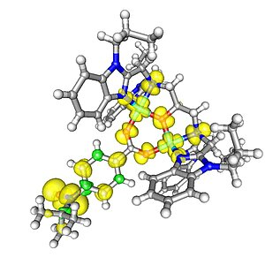
Spin in Density Functional Theory
Aury Marcela Castro Acosta

Slide 2
Introduction Spin in Non-Relativistic Quantum Mechanics Hohenberg–Kohn Theorems Extended to Spin Kohn–Sham Formulation in DFT with Spin Restricted and Unrestricted Formulations Conclusions References
Content

Slide 3
Introduction to Density Functional Theory

Slide 4
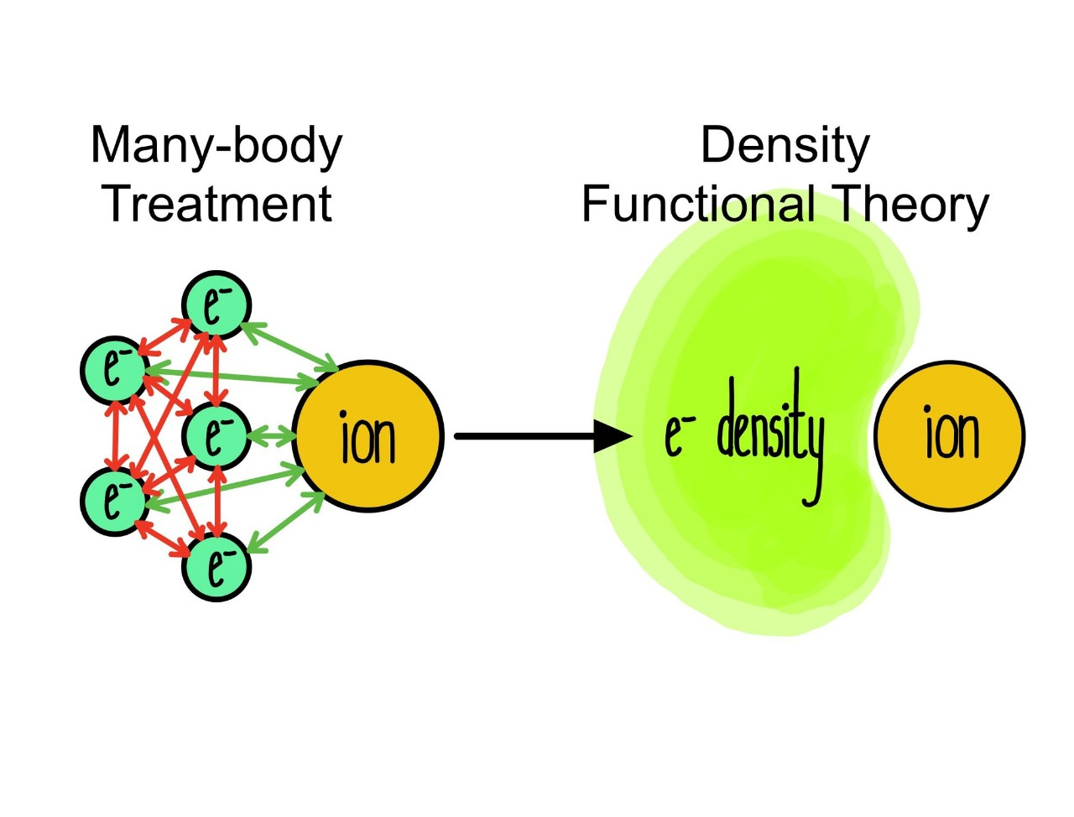
What is Density Functional Theory (DFT)?
It is a method that allows calculating the energy and electronic properties of materials and molecules using the electron density instead of the wave function.

Slide 5
Spin in Non-Relativistic Quantum Mechanics

Slide 6

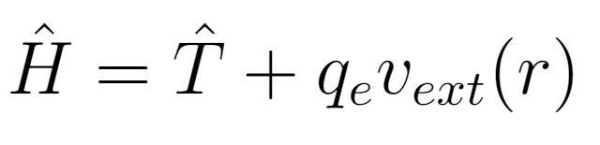
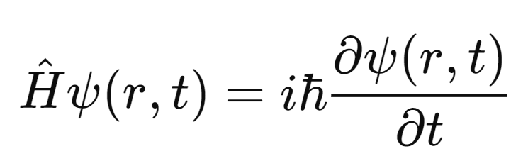
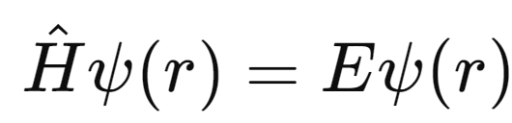
Spin in Non-Relativistic Quantum Mechanics
Schrödinger Equation: The equation of motion for an electron in an external potential
Time-dependent
Time-independent
Electron’s Hamiltonian

Slide 7
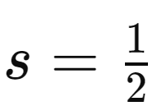
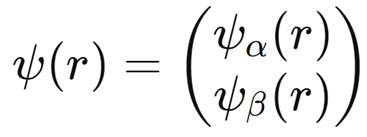
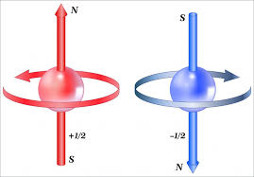
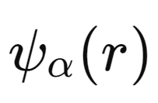
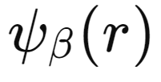

To incorporate spin in non-relativistic mechanics:
The electron is assigned an intrinsic spin with a fixed value
The wavefunction is extended to a two-component form:
Where
describe the spatial parts for spin-up (+ $\frac{1}{2}$)
spin-down states (-$\frac{1}{2}$)

Slide 8

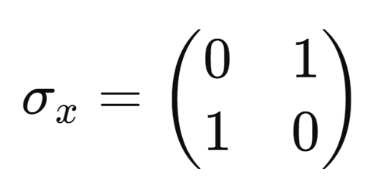
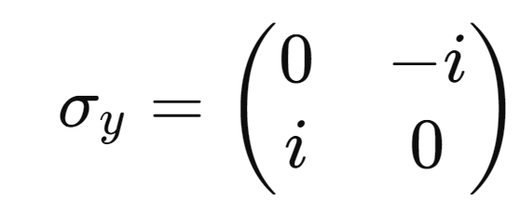
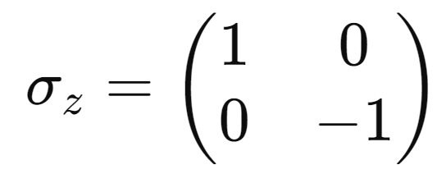
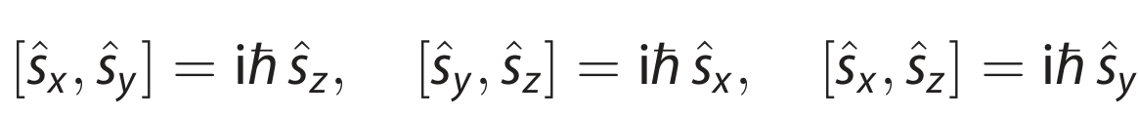
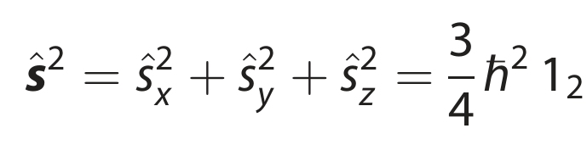
Spin Operators
Spin is described by operators constructed using Pauli matrices
Spin components
Commutation relations
Total spin magnitude

Slide 9
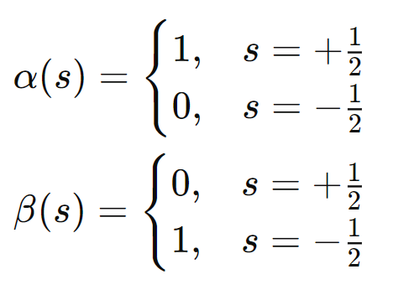
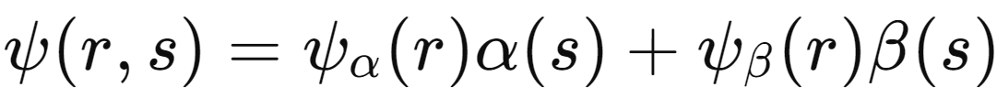


Spin Functions
Spin states are represented by basis functions
These functions indicate that an electron in the $α(s)$
while in β(s), it has spin-down ($−\frac{1}{2})$
state has spin-up ($+\frac{1}{2})$
The total wavefunction combines spatial and spin components:

Slide 10

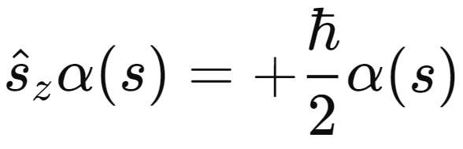
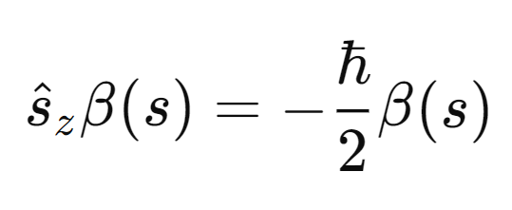


Spin Operator
The spin operator acts on the spin basis functions, producing their corresponding eigenvalues:
For $α\left(s\right):$
For $β\left(s\right):$
This means $α(s)$ is an eigenstate of ${\hat{S}}_{z}$ with eigenvalue +ℏ/2 ​, and $β(s)$ is an eigenstate with eigenvalue - ℏ/2

Slide 11
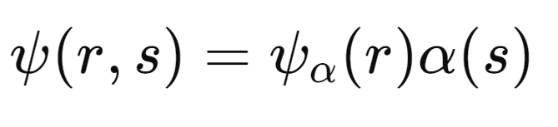
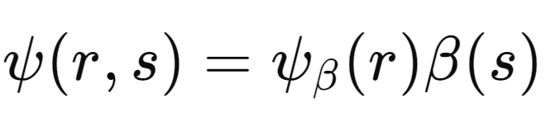
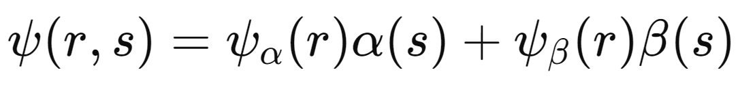
Total Wavefuntion
The total wavefunction combines the spatial and spin components, distinguishing between spin-up and spin-down states:
Spin-up:
Spin-down:
The total wavefunction combines spatial and spin components

Slide 12
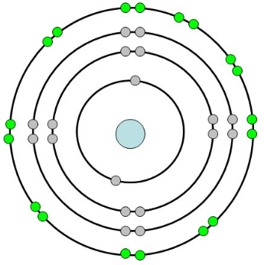

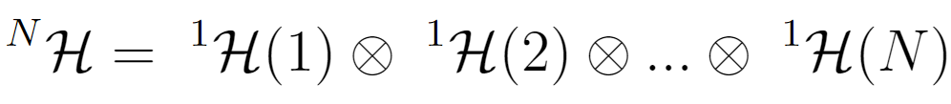

Generalization to Many-Electron Systems
N Electrons
Hilbert Space of one electron
$2^{N}$-Dimensional
Hilbert Space of the N electrons

Slide 13
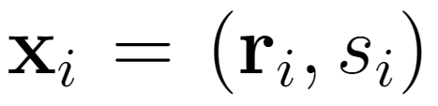
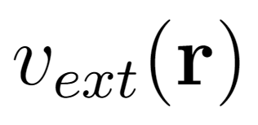

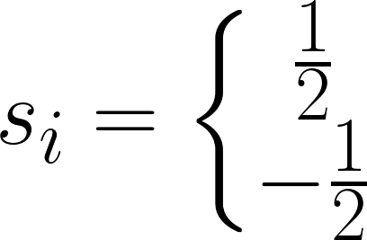
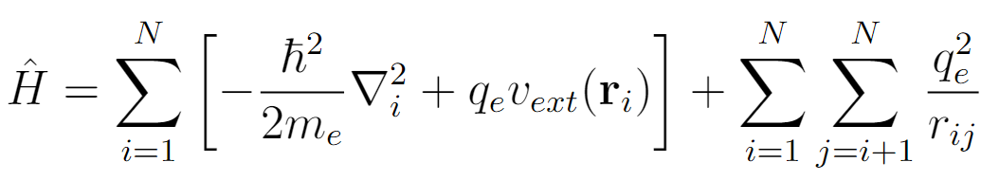
Many-Electron Wavefunction
Ext. Electrostatic Potential
Hamiltonian of the N-Electrons System

Slide 14
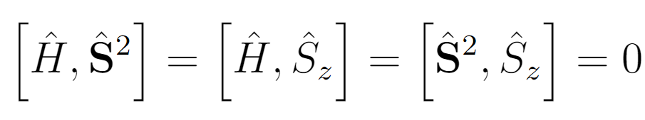
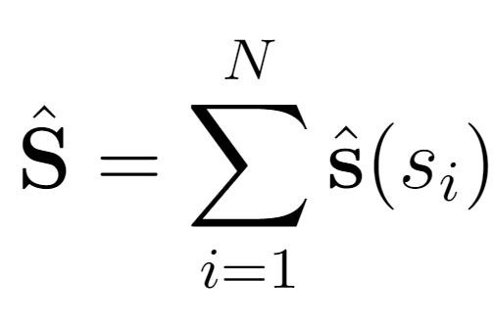
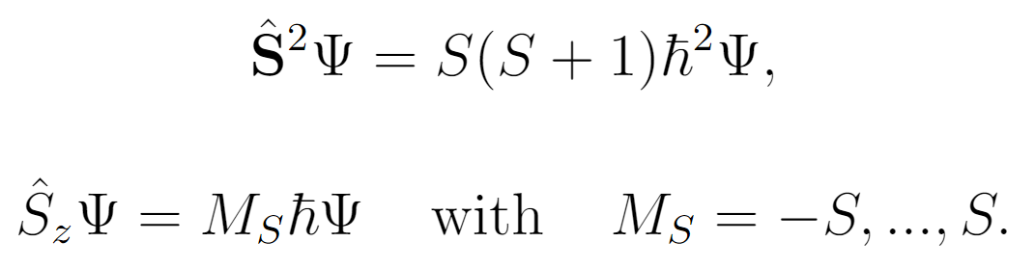
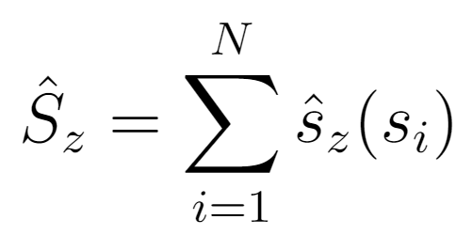
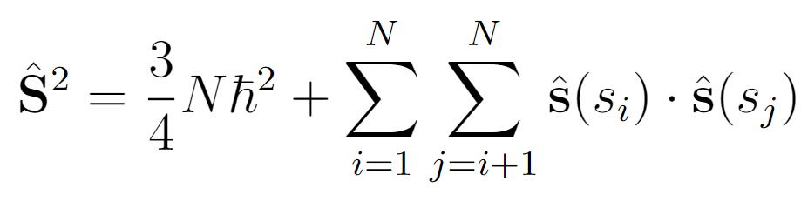
Many-Electron Spin Operator
N-Electrons Spin Operator
z-Component Spin Operator

Slide 15
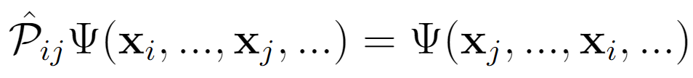
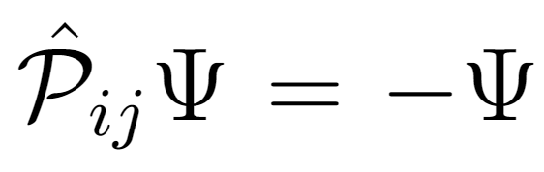
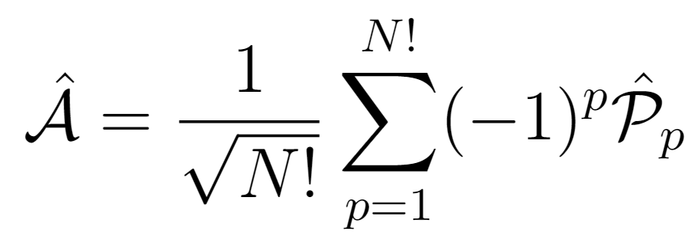
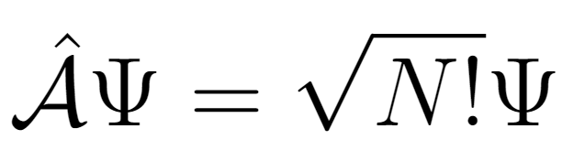
Antisymmetrization of the N-Electrons Wavefunction
Permutation Operator
Antisymmetrizer

Slide 16
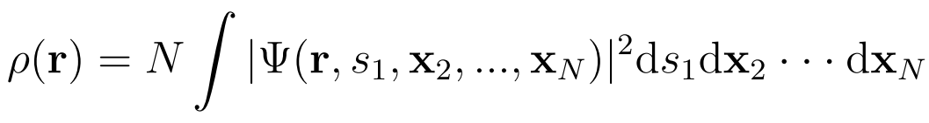
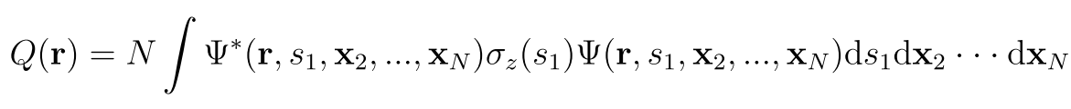
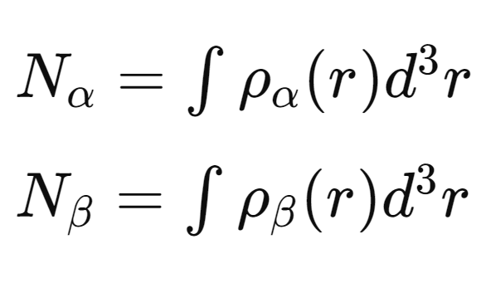
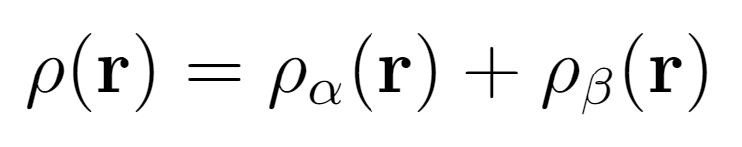
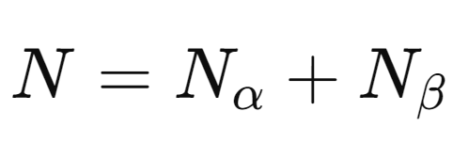
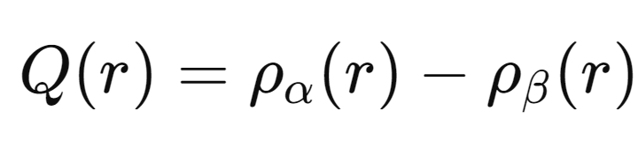
Total Electron Density and Spin Density
Electron density $ρ\left(r\right)$ probability of finding any electron at position $r$:
Spin density $Q(r)$: Difference between spin-up ($α$) and spin-down ($β$) electron densities
Total Number of Electrons

Slide 17
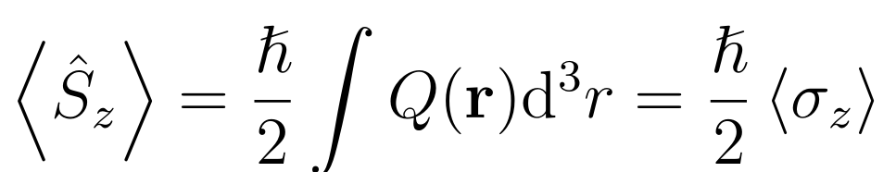
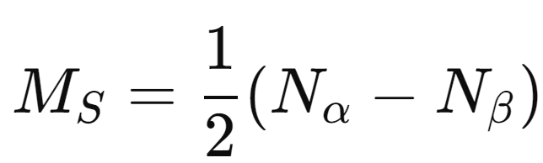
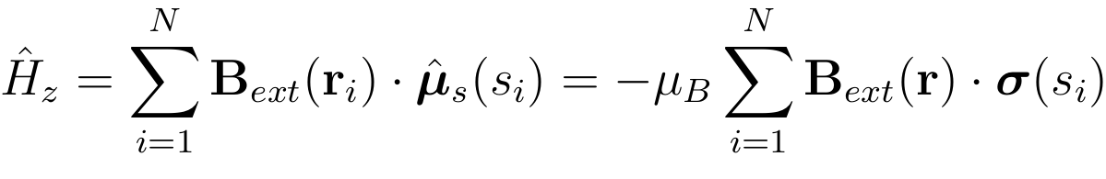
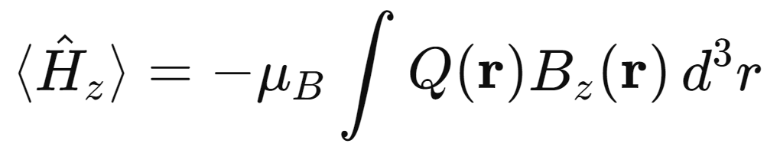
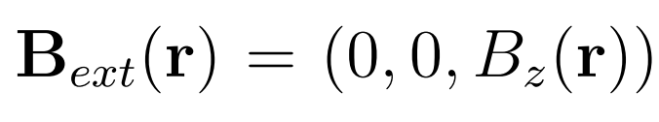

Some Expected Values
Expected value of Spin Operator ${\hat{S}}_{z}$
Spin projection eigenvalue
External Magnetic Field
Interaction Hamiltonian
Expected value

Slide 18
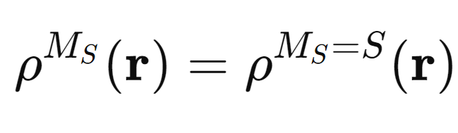
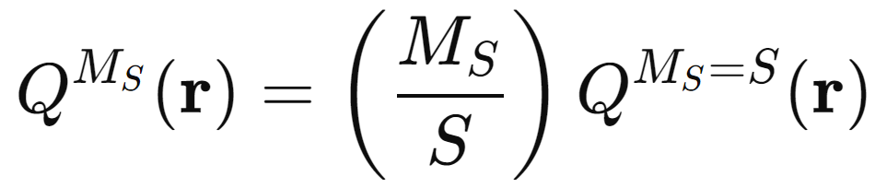



Electron Density and Spin Degeneracy
All $2S+1$ eigenstates of ${\hat{S}}^{2}$​ share the same total electron density:
Spin Density Scaling: The spin density $Q^{M_{S}}(r)$ scales with $M_{S}$​ as:
For $M_{S}​=0$ ; $Q(r)=0$
For

Slide 19
Hohenberg–Kohn Theorems Extended to Spin

Slide 20


First Hohenberg–Kohn (HK) Theorem
$ρ(r)$ and $Q(r)$ uniquely determine the external potential $v_{ext}\left(r\right)$ (up to a constant).
Since $v_{ext}\left(r\right)$ determines $\hat{H}$, the ground-state wavefunction and all system properties are also uniquely determined.

Slide 21





Second Hohenberg–Kohn Theorem
There exists a universal energy functional $E[ρ,Q]$ that depends on both $ρ(r)$ and $Q(r)$.
The ground-state energy ​$E_{0}$ is obtained by minimizing this functional, subject to constraints on the number of electrons and spin states.
The energy functional can be written as:
Where $F_{HK}​[ρ,Q]$ is the universal functional describing the kinetic and electron-electron interaction energies.

Slide 22






Spin Density Extension of HK-DFT
For a fixed $M_{S}$
Ground-State densities are achieved by minimizing the generalized HK functional:
Vital for describing open-shell systems such as magnetic materials!!

Slide 23


Spin States in HK-DFT
The Hohenberg–Kohn theorems are extended to calculate the lowest-energy state for a specific spin $S$, beyond the ground state.
To find the lowest-energy state for a given spin $S$, a spin-specific energy functional is defined.
In spin-DFT, spin selection is approximated using the spin projection , constraining energy minimization to states with

Slide 24
Spin in Kohn-Sham Densitiy Functional Theory

Slide 25

Introduction of a Reference System
Interacting Electrons
Noninteracting Electrons

Slide 26





Spin-Restricted Kohn–Sham DFT
The Kohn–Sham Hamiltonian describes a system of non-interacting electrons:
Noninteracting Electrons
The wavefunction of the non-interacting reference system is expressed as a Slater determinant :
$φ_{i}​\left(x\right)≡$ one-electron spin orbitals for $α$ and $β$ electrons.
The spin densities and total density are obtained

Slide 27


KS Energy Functional
Total energy functional of the interacting system
Exchange-correlation energy functional
Coulomb interaction of the electrons
In spin-restricted KS-DFT, $ρ(r)$ is identical for $α$ and $β$ electrons. This simplifies calculations for closed-shell systems, assuming the non-interacting reference system matches the true density. However, it is less accurate for open-shell systems with significant spin polarization.

Slide 28




Spin-Unrestricted Kohn–ShamDFT
KS Hamiltonian
External Magnetic Field
Wavefunction for a non-interacting spin-unrestricted system:
Spin contamination arises because $Ψ$ is not an eigenfunction of ${\hat{S}}^{2}$:

Slide 29


The total density is the sum of $α$ and $β$ contributions:
The spin density:
The total energy functional
The total energy of the interacting system

Slide 30
Comparison of restricted and unrestricted formulation

Slide 31

Spin-Unrestricted vs Spin-Restricted

Slide 32
Conclusions

Slide 33

Importance
Essential for accurately describing electronic systems with magnetic interactions.
Theoretical Advances
Extension of the Hohenberg-Kohn theorems to spin-dependent systems.
Computational Challenges
Issues such as spin contamination in unrestricted formulations.
Current Limitations
Open-Shell Systems, Fractional Spin States.

Slide 34
References
1
Helgaker, T.; Jørgensen, P.; Olsen, J. Molecular Electronic Structure Theory; Wiley, 2000.
2
Koch, W.; Holthausen, M. C. A Chemist's Guide to Density Functional Theory; Wiley-VCH, 2001.
3
Noodleman, L. J. Chem. Phys., 1981, 74, 5737.
G. A. Timco, S. Carretta, F. Troiani, F. Tuna, R. J. Pritchard, C. A. Muryn, E. J. L. McInnes, A. Ghirri, A. Candini, P. Santini, G. Amoretti, M. Affronte, R. E. P. Winpenny,
Nat. Nanotech. 2009, 4, 173.
4

Slide 35
Michael G. Raymer, Tiemo Landes, Andrew H. Marcus; Entangled two-photon absorption by atoms and molecules: A quantum optics tutorial. J. Chem. Phys. 28 August 2021; 155 (8): 081501.
9
M. Caracas Núñez, M. A. Gonzalez, and M. Núñez Portela, “Theoretical and experimental study of the 6S-8S two-photon absorption cross-section in cesium atoms,” Opt. Express, vol. 31, no. 20, p. 31749, Sep. 2023.
10

Slide 36


Thanks!

